Slide 1
Scientific Roadmap Planning
Characterization of research projects according to All of Us scientific priorities
Presented by Lina Sulieman, PhD, All of Us Data and Research Center
All of Us, the All of Us logo, and “The Future of Health Begins with You” are service marks of the U.S. Department of Health and Human Services.

Slide 2
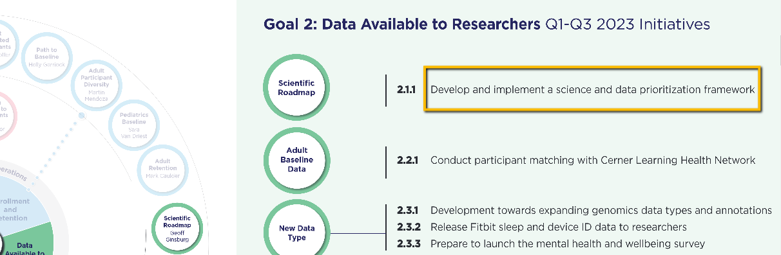
All of Us Research Program 5 Years Vision
AoU developed an inventory of initiatives planned for completion within FY23 to meet the program’s 5 year goals. This project was completed to support Goal 2, Objective 2.1.1.

Slide 3
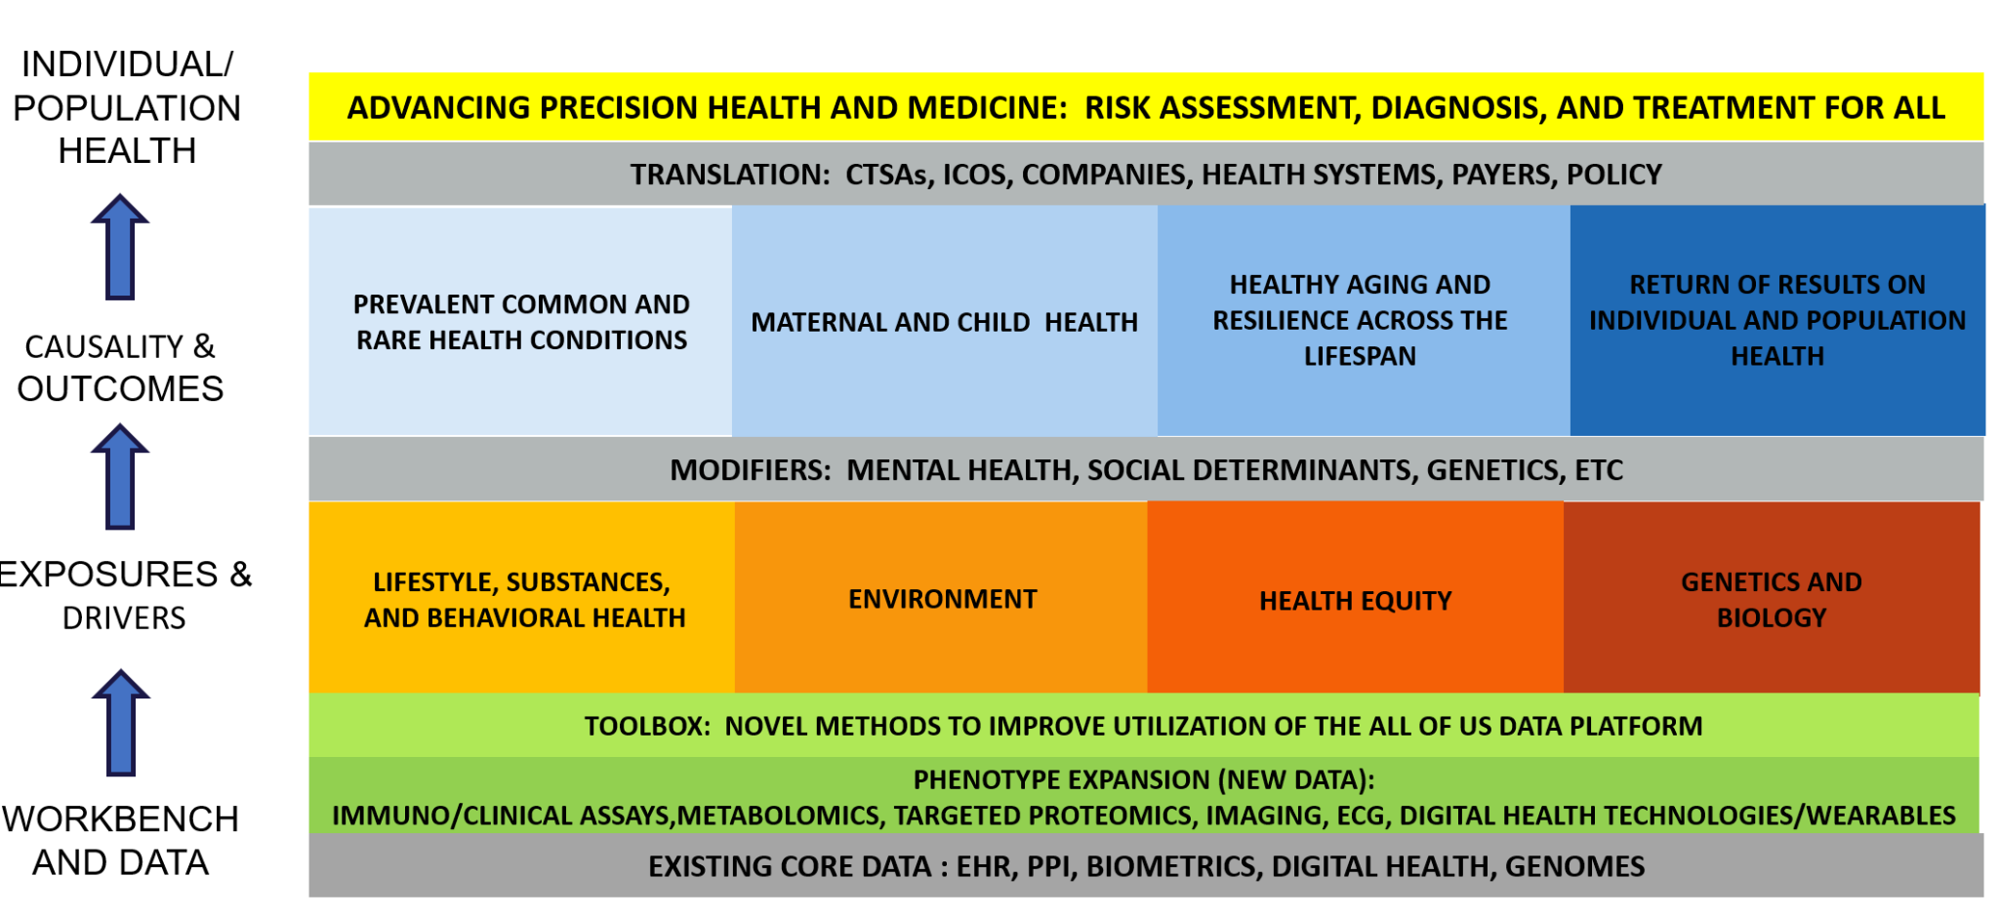
Background – Eight Focus Areas to Monitor New scientific Framework

Slide 4
Goal
Building automated project classification pipeline to identify portfolio of ongoing research studies

Slide 5
Quantifying the Scientific Roadmap in the All of Us Research Program
8 Scientific categories
Diseases analyzed by researchers
Data domain used

Slide 6
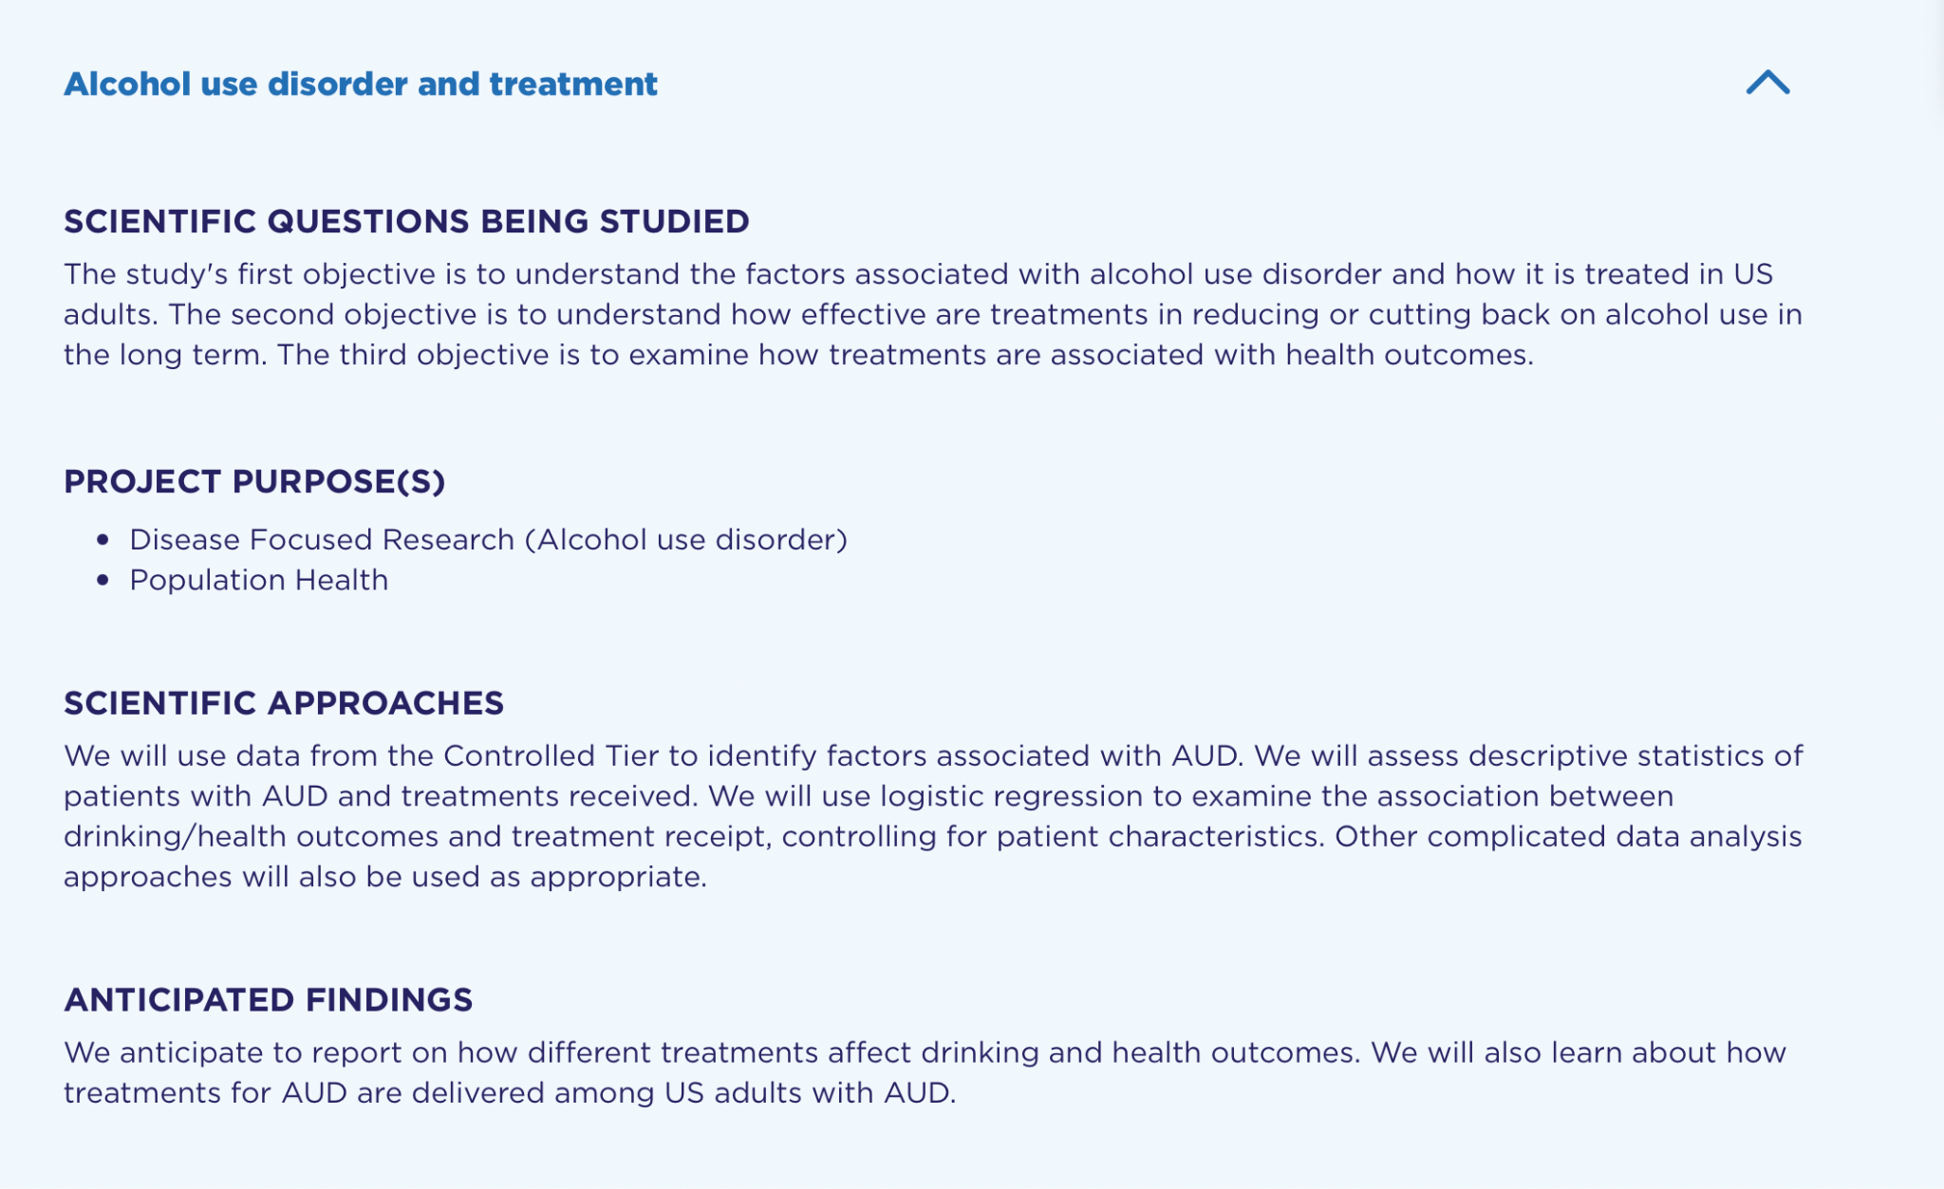
Project In All of Us Directory Description Sources - Free Text
Title
Intent
Researcher-provided disease
Findings

Slide 7
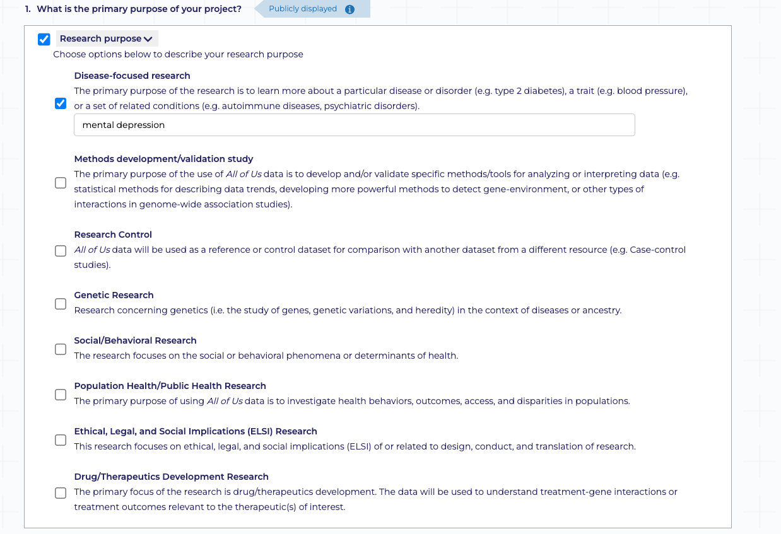
Project In All of Us Directory Description - Other MetaData

Slide 8
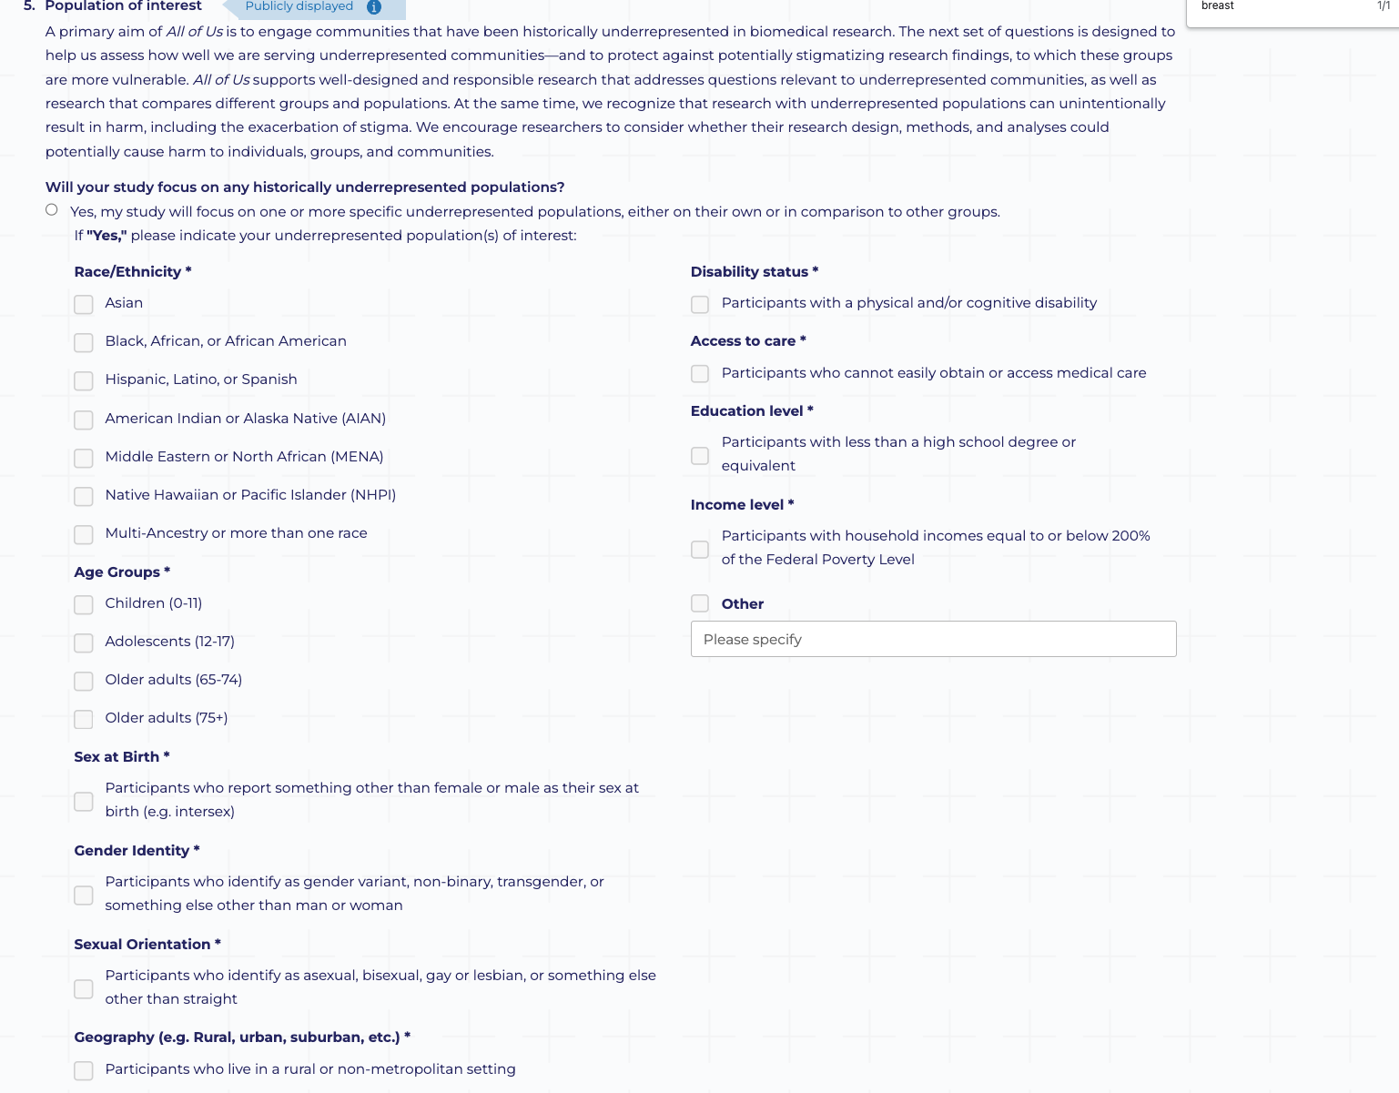
Project In All of Us Directory Description - Other MetaData

Slide 9
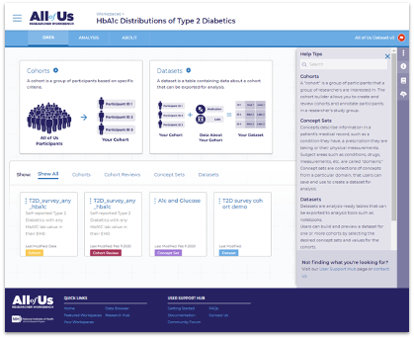
All of Us Cohort and Dataset Builders
Cohort Builder: Using All of Us data to build cohorts
Information about cohort including:
Cohort identifier
Data domain: condition, Procedures
Concept type: SNOMED, ICD
Concept names

Slide 10
Quantifying the Scientific Roadmap in the All of Us Research Program
8 Scientific categories
Diseases analyzed by researchers
Data domain used

Slide 11
Quantifying the Scientific Roadmap in the All of Us Research Program
Scientific categories
Diseases analyzed by researchers
Data domain used
Data Source
Workspace description
Meta Data
Title, intent, and finding
Research Purpose
Population of interest
Cohort Information

Slide 12
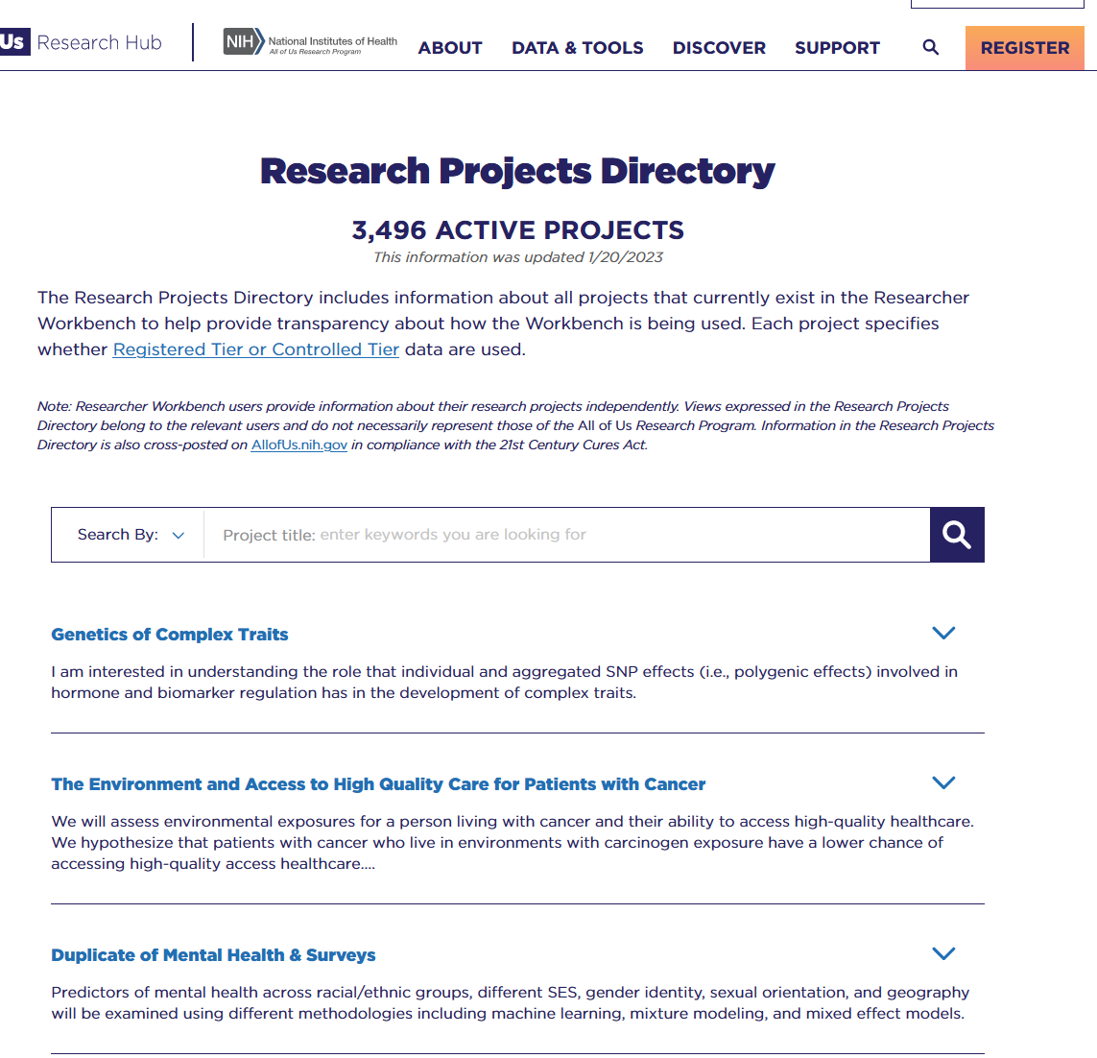
Methods - Workspace Inclusion Created 5/29/20 - 3/1/23
3851 Workspaces
Exclusions
Operational workspaces
430
3421 Workspaces
Inactive workspaces 12
3409 Workspaces
Duplicated workspaces: 454
Identified by Program
Duplicated word
2955 Workspaces
Test, Featured workspaces, excluded: 26
2981 Workspaces

Slide 13
Identifying Scientific Categories

Slide 14
Identifying Scientific Categories in Workspaces
Free Text
Meta Data
Source
Title, intent, and finding
Research Purpose
Population of interest
Extraction
Identified scientific categories using keywords existence.
Keywords based on A-Z lists of research topics/health conditions
Applicable NIH center/institute websites
Medline Plus
MeSH Browser
Informal evidence scans to identify additional common research topics/health condition trends
Genetic Research→ Genetics & Biology
Social/Behavioral Research→ Lifestyle, Substance, & Behavioral Health
Population Health/Public Health→Return of Results on Individual & Population Health
Health equity

Slide 15
Results - Until March 2981 Workspaces Analyzed - Keywords
Number of Workspaces Mapped to Scientific Focus Areas Based on Coding Scheme
Category | Subset keywords* | All Keywords | Keywords* + Project purpose | Keywords* + Project purpose+ population
Prevalent Common & Rare Conditions | 1321 | 1956 | 1321 | 1321
Maternal & Child Health | 184 | 184 | 184 | 184
Health Aging & Resilience Across Lifespan | 311 | 311 | 311 | 311
Return of Results on Individual & Population Health | 28 | 28 | 835 | 835
Lifestyle, Substance, & Behavioral Health | 503 | 503 | 808 | 808
Environment | 522 | 522 | 522 | 522
Health Equity | 1951 | 1951 | 1951 | 2197
Genetics & Biology | 1826 | 1826 | 1887 | 1887
Total workspaces that map according to scheme | 2800 | 2853 | 2821 | 2851
Total workspaces that do not map/require manual review | 181 | 128 | 160 | 130
* Common disease limited to top leading causes of death (https://www.cdc.gov/nchs/fastats/leading-causes-of-death.htm)

Slide 16
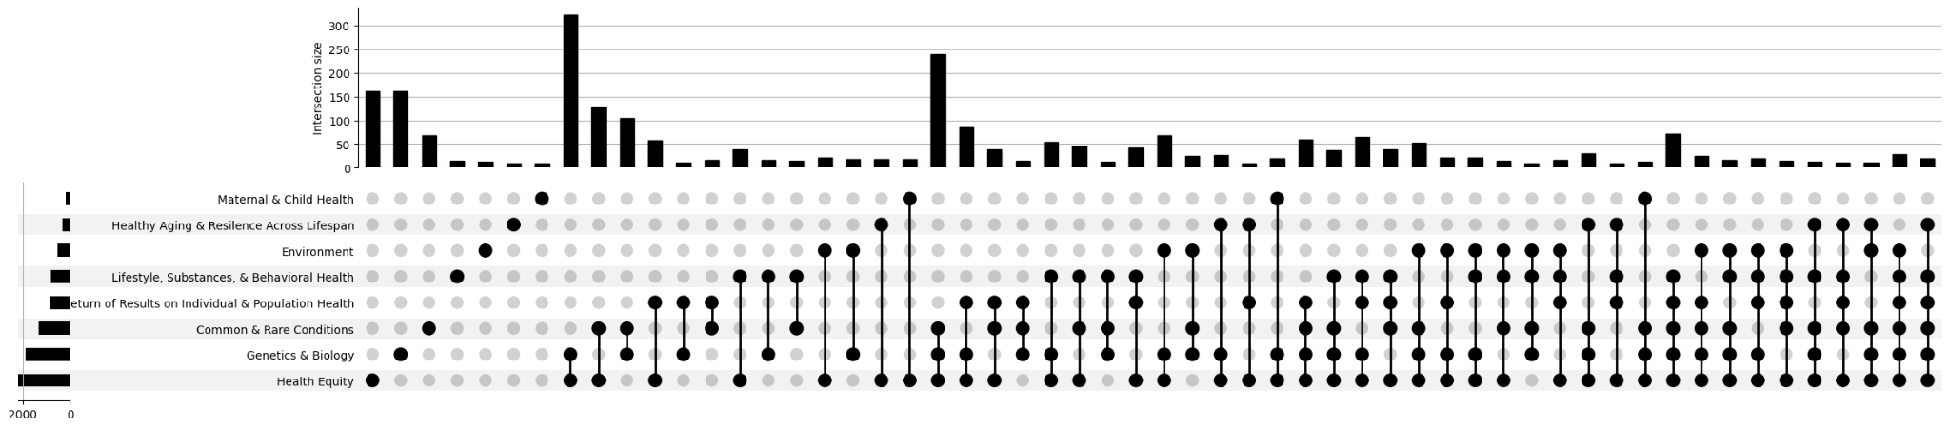
Projects Categories Intersection - Genetics, common/rare condition, and health equity are Most Common Subset
*Showing subsets with more than 10 workspaces

Slide 17
Non-Mapped Projects Themes
Diseases Not listed
NIV Failure
ADHA
Psoriatic
Medications
Metformin
Adverse drug prediction
Health Outcome
Readmission
Exploring the data and educational projects

Slide 18
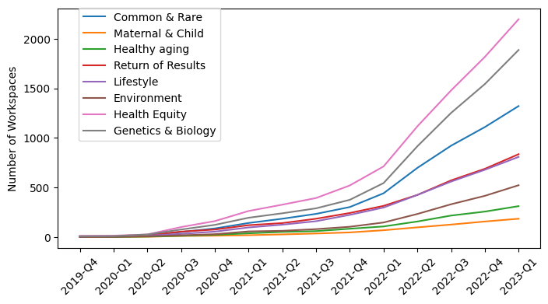
Temporal Analysis - Genetics and Health Equity had a Big Jump in 2022-Q1

Slide 19
Disease Profile From Project Description

Slide 20
Disease Extraction from Workspace Description
CLAMP: Tool that extracts medical terms and diseases:
Title
Intent
Findings
For Disease Focused Research: Keywords entered by researchers
Ranked most frequent researched diseases using:
Frequency in Title, Intent, and Finding
Weighted terms based
Workspace has researcher entered disease
Researcher
0.3
Title
0.3
Intent
0.2
Finding
0.2
+
+
+
Example
Term weight in Workspace
Hypertension term exist in title and finding in workspace 122
Weight hypertension for Workspace 122 = 0.8
Title
0.6
Workspace without researcher entered disease
+
Intent
0.2
+
Finding
0.2

Slide 21
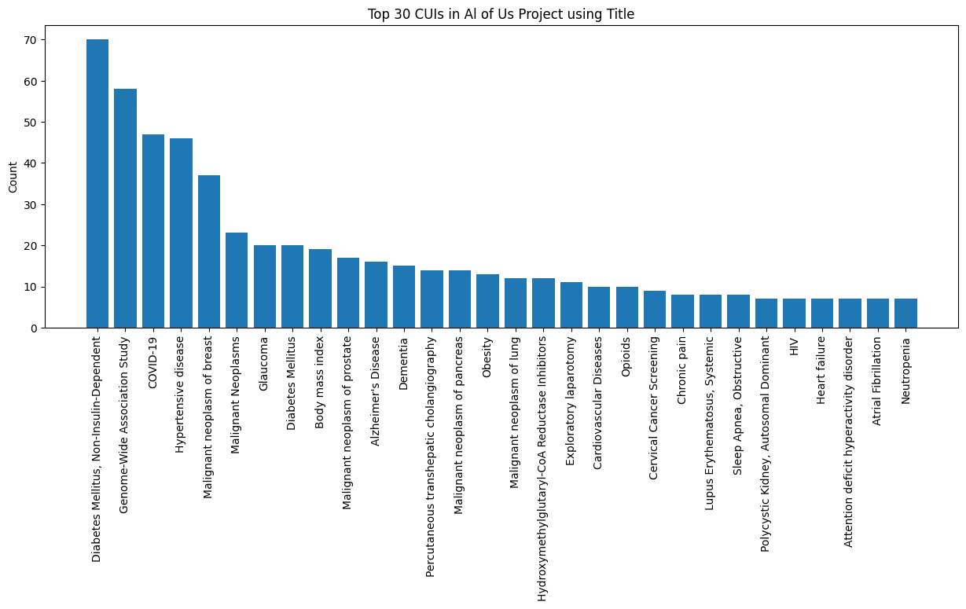
Top 30 CUIs in All of Us Workspaces Extracted from Titles

Slide 22
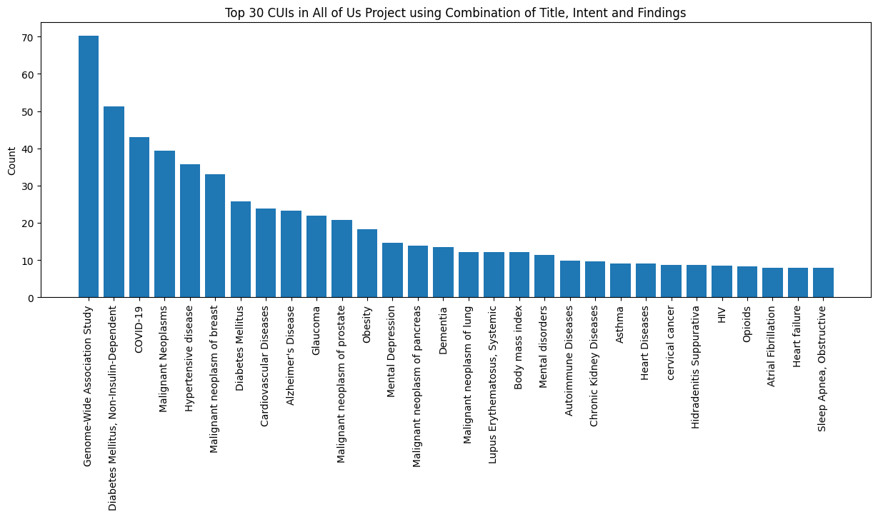
Top 30 CUIs in All of Us Workspaces Extracted from Title, Intent, & Findings

Slide 23
Disease In Each Scientific Map Category

Slide 24
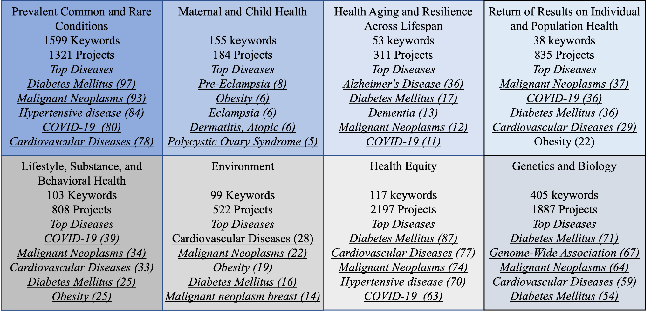
Top Diseases Studied in 2981 Workspaces per Scientific Category

Slide 25
Analysis Common Used All of Us Domains When using All of Us Research Programs Graphic Tools

Slide 26
All of Us Cohort and Dataset Builders
Information about cohort including:
Cohort identifier
Data domain: condition, Procedures
Concept type: SNOMED, ICD
Concept names
For 2981 workspaces:
2079 workspaces used cohort builder
On average, workspaces had three to four cohorts

Slide 27
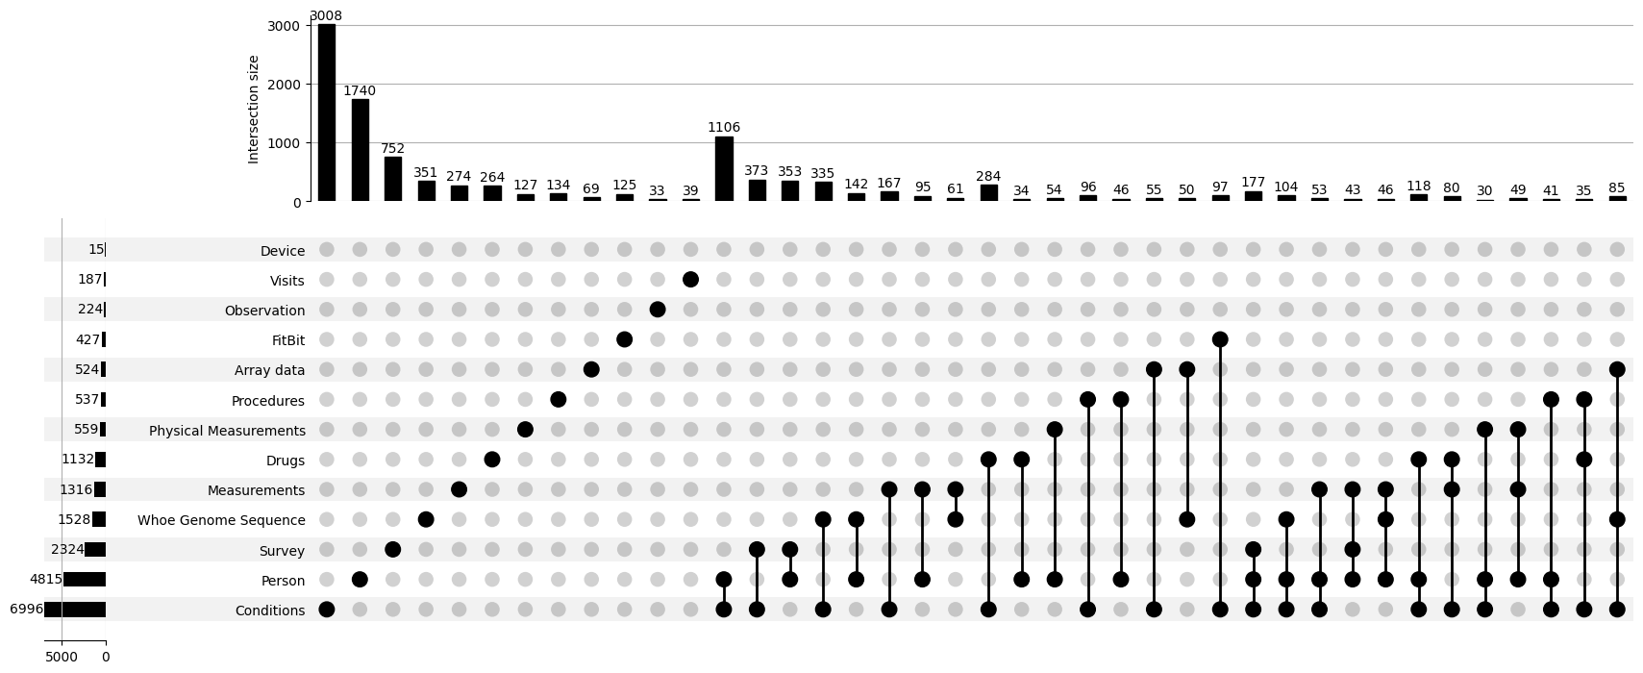
Workspaces Cohorts that Uses Person, conditions, or both are the Most Common Domain
<ost common

Slide 28
Workspaces Further Analysis

Slide 29
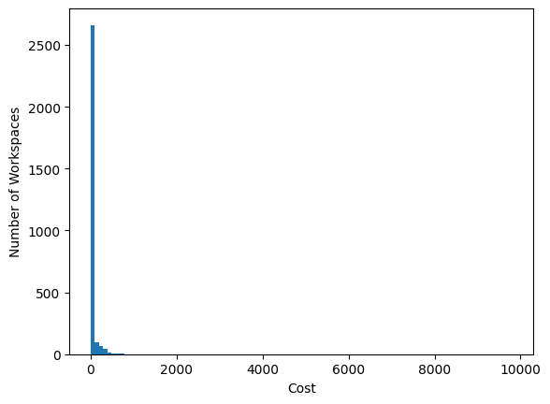
Cost in All Workspace
Mean: 36.167537
Median: 4.946999
SD: 207.581636
Minimum: 0.000573
Maximum: 9812.10, 15818.365

Slide 30
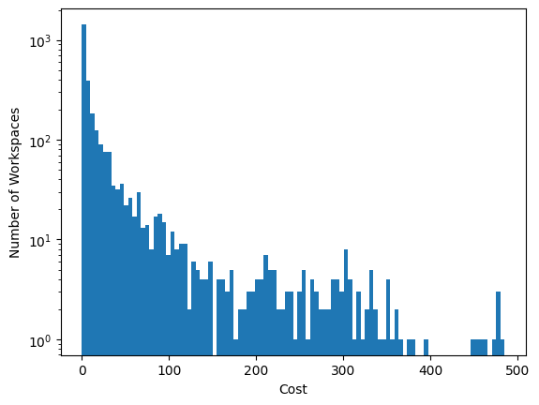
Cost in All Workspace

Slide 31
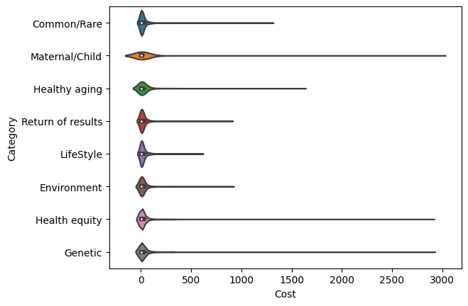
Cost of Workspaces per Scientific Category
One project in Lifestyle had more than 15,000

Slide 32
Project with High Cost
<1:
363 workspaces
>15000
Fitbit_mental(depression&anxiety)
>3000
Genetics: GWAS, Pathogenic variants
COVID
Wearable
Mental health
Deep learning

Slide 33
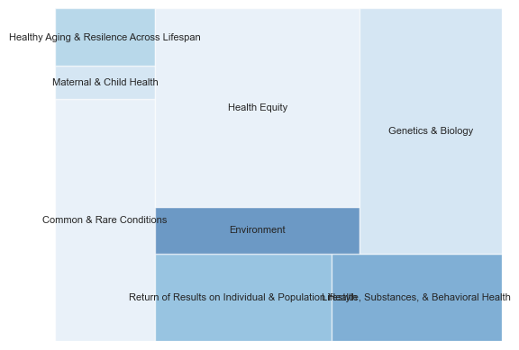
Visualization

Slide 34
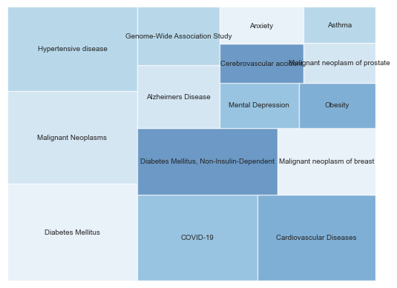

Slide 35
When A User Clicks on Diabetes Ranked by Term Weights
Basis of Diabetes and Diabetes-related Complications
The primary goal of the proposed analyses is to understand the genetic basis of diabetes and diabetes-related complications, including kidney disease…..
Diabetes
People from different group suffered diabetes disproportionately, what is the key risk factors associated with diabetes?
Diabetes
The long term goal of our work is to improve the diagnosis and clinical management of diabetes subtypes by translating recent advances in our understanding of genetic risk factors for diabetes. We….

Slide 36
Points To Discuss
Project inclusions:
Defining Active:
Time of creation: Keeping projects only in last year
Cost
Any specific use cases for NIH
Submissions:
Podium abstract to AMIA symposium
Lighting Talk for F2F meeting

Slide 37
Topics to Discuss - Geoff’s email
Understanding gaps in the scientific priorities roadmap (SPR) that need catalysis or stimulus from NIH
Understanding the impact of program announcements on getting researchers to the RWB (temporal evaluations)
Identifying announcement, may be point change analysis
Some more granularities around specific areas of disease focus within the different domains (8 focus areas + tools) can provide opportunities to develop programs with specific ICs
Grist for newsletter and program stories and highlights of the science from the community
Learning about areas that could benefit from a translational strategy.
Learning about science that was not on our roadmap – but should be ?
Evaluation of impact - a well characterized catalogue of research projects paired with publications and grant citations (and/or other downstream metrics);
Resource planning guidance (projects like this cost X);
Social engineering - finding collaborators (researcher)
IC representation/engagement

Slide 38
Meeting Notes
Adding why we are doing this and areas of impact
Impact vs productivity: overtime
Methods:

Slide 39
Extra Slides

Slide 40
Sample of Projects with Cost less
Title | Description
Asthma | Exploring diversity of childhood onset asthma....
SmokingCessation | Examine receipt of smoking cessation treatment...
miRNA research | Understanding genetic variation in the human g...
PPD GWAS | This project will be a part of my K01 grant (M...
Phenotype Creation | We seek to understand the association between ...
Von Willebrand Disease | I intend to study the association of genetic v...
Social Determinants of Colorectal Cancer | I plan to explore the social determinants of c...
Surveys- Application of IRT and CTT | The purpose of this study is to apply item res...

Slide 41
Methods - Coding & Data Analysis
Number of Coding Scheme Elements Prioritized by Focus Area
Translation
Prevalent Common & Rare Conditions (1599/1) | Maternal & Child Health (155/2) | Health Aging & Resilience Across Lifespan (52/2) | Return of Results on Individual & Population Health (38/0)
Modifiers
Lifestyle, Substance, & Behavioral Health (103/0) | Environment (99/0) | Health Equity (117/11) | Genetics & Biology (405/1)
Total: 2,302 keywords selected (red); 17 workspace description field variables selected in total (blue).

Slide 42
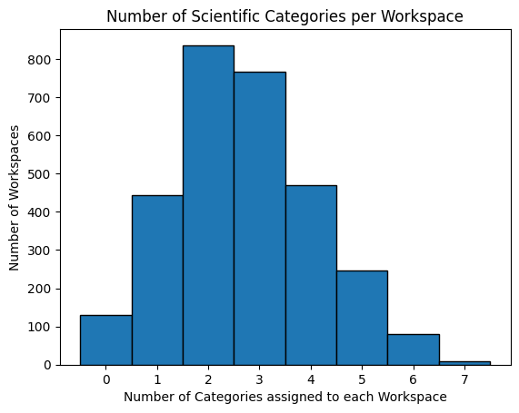
1603 Projects have 2-3 Categories identified using Keywords, Purpose, & Population
Number of projects with multiple categories 2407 workspaces
Number of projects with one category 444 workspaces

Slide 43
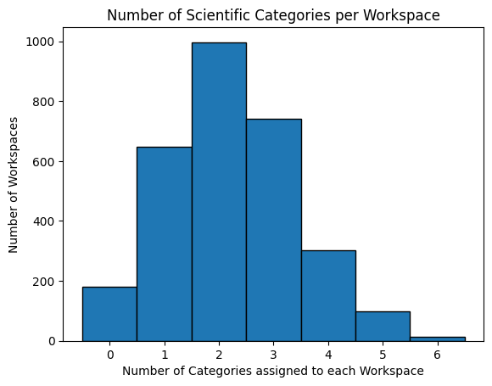
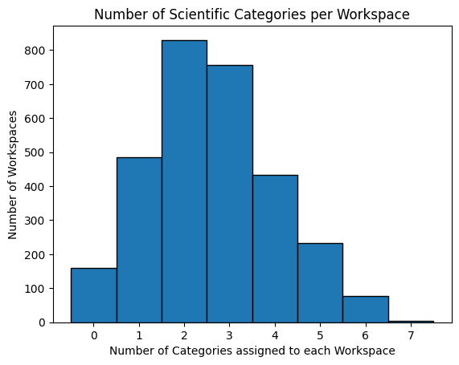
Number of Categories Assigned for Each Workspaces
Using Limited Keywords only
Using Limited Keywords and Research Purpose

Slide 44
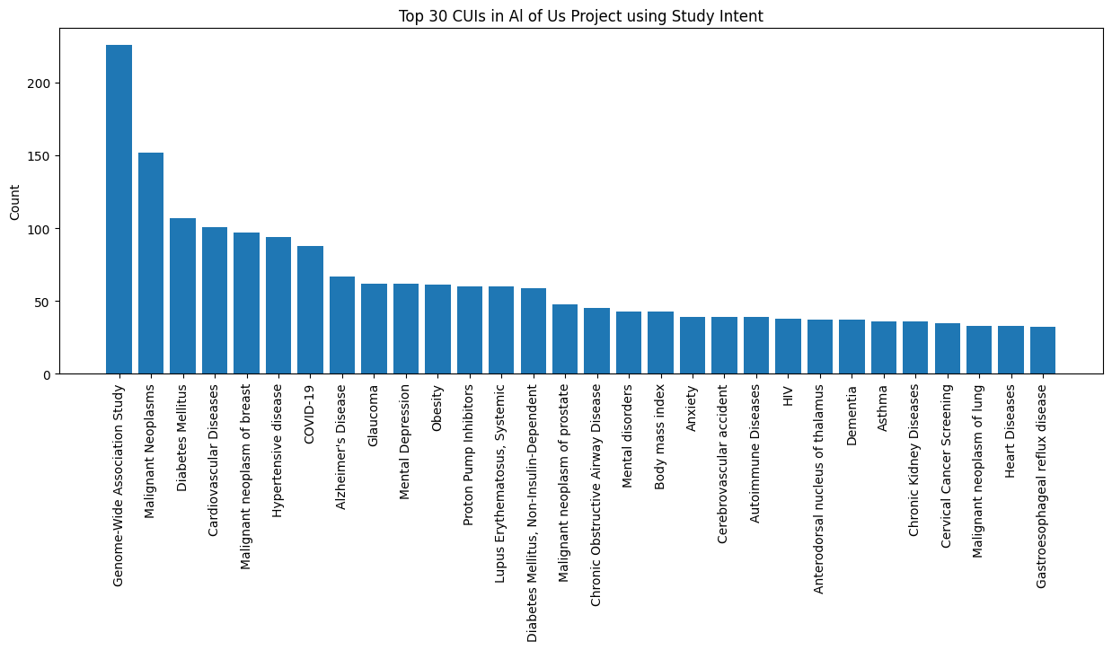
Top 30 CUIs in All of Us Workspaces Extracted from Study Intent

Slide 45
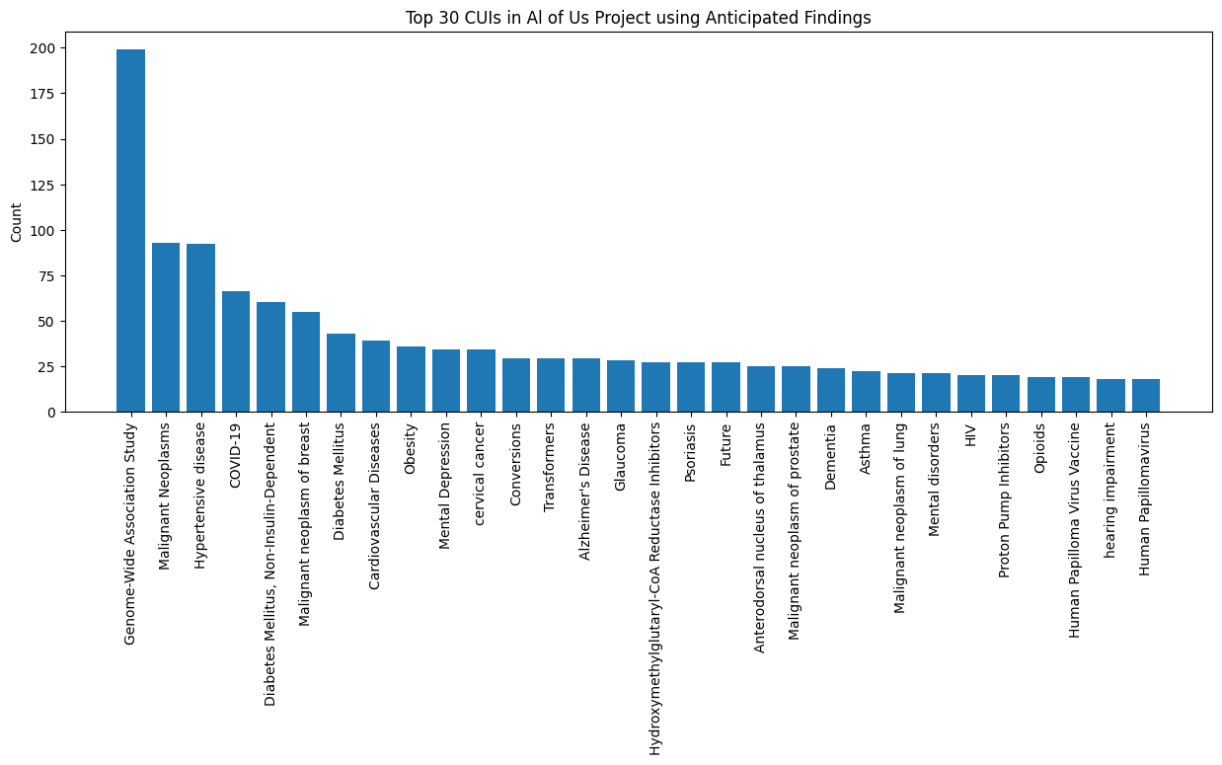
Top 30 CUIs in All of Us Workspaces Extracted from Anticipated Findings

Slide 46
Common and rare conditions | Maternal and child health | healthy aging and resilience | Return of results on individual, population | Lifestyle Substance, behavioral | Environment | Health equity | Genetics and biology
COVID-19 | Dermatitis, Atopic | Alzheimer's Disease | COVID-19 | COVID-19 | Cardiovascular Diseases | COVID-19 | Diabetes Mellitus, Non-Insulin-Dependent
Hypertensive disease | Eclampsia | Dementia | Malignant Neoplasms | Malignant Neoplasms | Glaucoma | Hypertensive disease | Malignant Neoplasms
Malignant Neoplasms | Polycystic Ovary Syndrome | COVID-19 | Malignant neoplasm of prostate | Glaucoma | Malignant neoplasm of prostate | Diabetes Mellitus, Non-Insulin-Dependent | Malignant neoplasm of breast
Diabetes Mellitus, Non-Insulin-Dependent | Endometriosis | Malignant Neoplasms | Cardiovascular Diseases | Cardiovascular Diseases | Malignant Neoplasms | Malignant Neoplasms | Genome-Wide Association Study
Malignant neoplasm of breast | Gestational Diabetes | Degenerative polyarthritis | Diabetes Mellitus, Non-Insulin-Dependent | Malignant neoplasm of lung | Malignant neoplasm of breast | Diabetes Mellitus | Glaucoma
Diabetes Mellitus | Bacterial Vaginosis | HIV | Diabetes Mellitus | Obesity | Diabetes Mellitus | Cardiovascular Diseases | Malignant neoplasm of prostate
Alzheimer's Disease | Pre-Eclampsia | Diabetes Mellitus, Non-Insulin-Dependent | Malignant neoplasm of breast | Mental disorders | Obesity | Malignant neoplasm of breast | Diabetes Mellitus
Cardiovascular Diseases | Turner Syndrome | Hypertensive disease | Obesity | Mental Depression | Asthma | Malignant neoplasm of prostate | COVID-19
Malignant neoplasm of prostate | Obesity | Cardiovascular Diseases | HIV | Body mass index | COVID-19 | Alzheimer's Disease | Malignant neoplasm of pancreas
Malignant neoplasm of pancreas | Depression, Postpartum | Inappropriate ADH Syndrome | Malignant neoplasm of lung | HIV | Alzheimer's Disease | Genome-Wide Association Study | Alzheimer's Disease
Genome-Wide Association Study | Scoliosis, unspecified | Headache Disorders | Mental Depression | Hypertensive disease | Malignant neoplasm of lung | Malignant neoplasm of pancreas | Cardiovascular Diseases
Malignant neoplasm of lung | Attention deficit hyperactivity disorder | Diabetes Mellitus | Mental disorders | Opioids | Malignant neoplasm of pancreas | Glaucoma | Hypertensive disease
Asthma | COVID-19 | Pancreatitis, Chronic | Hypertensive disease | Diabetes Mellitus, Non-Insulin-Dependent | Diabetes Mellitus, Non-Insulin-Dependent | Mental disorders | Body mass index
Obesity | Cardiovascular Diseases | Neurodegenerative Disorders | Major Depressive Disorder | Malignant neoplasm of prostate | Dementia | Mental Depression | Chronic Kidney Diseases
Chronic Obstructive Airway Disease | Congenital heart disease | Mild cognitive disorder | Asthma | Diabetes Mellitus | Mental Depression | Obesity | Diabetes Mellitus, Non-Insulin-Dependent

Slide 47
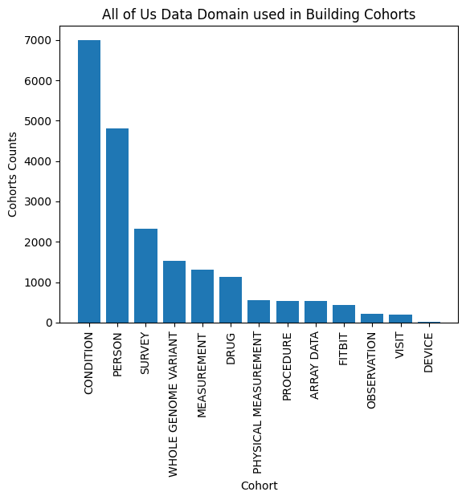
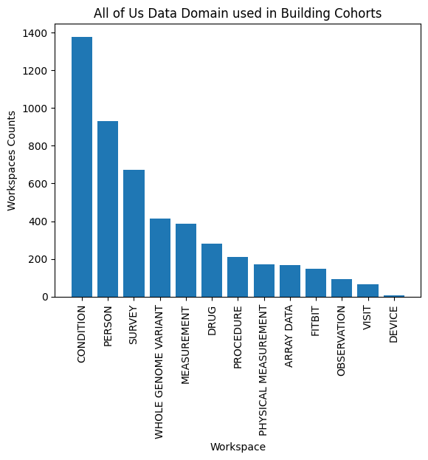
12533 Cohort Built in 2079 Workspace, Mainly Conditions used To Build Cohorts

Slide 48
Older slides

Slide 49
Background
8 focus areas support development of an organized All of Us research portfolio to evaluate & monitor the new scientific framework.

Slide 50
Project In All of Us Directory Description Sources - Free Text

Slide 51
Project In All of Us Directory Description - Other MetaData

Slide 52
Project In All of Us Directory Description - Other MetaData

Slide 53
Methods - Output of Analyzing Workspaces
Free Text
Meta Data
Source
Title, intent, and finding
Research Purpose
Population of interest
Cohort Information
Extracted Information
Scientific categories
Diseases analyzed by researchers
Data domain used

Slide 54
Methods - Output of Analyzing Workspaces
Free Text
Meta Data
Source
Title, intent, and finding
Research Purpose
Population of interest
Cohort Information
Extracted Information
Scientific categories
Diseases analyzed by researchers
Data domain used

Slide 55
Identifying Scientific Categories

Slide 56
Methods - Workspace Inclusion Created 5/29/20 - 3/1/23
3851 Workspaces
Exclusions
Operational workspaces
430
3421 Workspaces
Inactive workspaces 12
3409 Workspaces
Duplicated workspaces: 454
Identified by Program
Duplicated word
2955 Workspaces
Test, Featured workspaces, excluded: 26
2929 Workspaces

Slide 57
Identifying Scientific Categories in Workspaces
Free Text
Meta Data
Source
Title, intent, and finding
Research Purpose
Population of interest
Identified scientific categories using keywords existence.
Keywords based on A-Z lists of research topics/health conditions
Applicable NIH center/institute websites
Medline Plus
MeSH Browser
Informal evidence scans to identify additional common research topics/health condition trends
Genetic Research→ Genetics & Biology
Social/Behavioral Research→ Lifestyle, Substance, & Behavioral Health
Population Health/Public Health→Lifestyle, Substance, & Behavioral Health
Health equity
Extraction

Slide 58
Methods - Coding & Data Analysis
Coding scheme inclusion:
Relevant workspace description fields (ex. if “genetic” research purpose selected, catalog as “genetics & biology”)
List of keywords based on A-Z lists of research topics/health conditions hosted on applicable NIH center/institute websites, Medline Plus, & MeSH Browser. Supplemented by informal evidence scans to identify additional common research topics/health condition trends
Workspace description data exported from DRC REDCap system, extracted
Project title
Intent or project description
Anticipated finding
Project purpose
Population of interest
Programatically coded workspace description fields based on coding scheme using:
The existence of keywords in title, intent, and findings provided in this document
Project purpose selected by researcher
Selecting population of interest: Health equity category

Slide 59
Methods - Coding & Data Analysis
Number of Coding Scheme Elements Prioritized by Focus Area
Translation
Prevalent Common & Rare Conditions (1599/1) | Maternal & Child Health (155/2) | Health Aging & Resilience Across Lifespan (52/2) | Return of Results on Individual & Population Health (38/0)
Modifiers
Lifestyle, Substance, & Behavioral Health (103/0) | Environment (99/0) | Health Equity (117/11) | Genetics & Biology (405/1)
Total: 2,302 keywords selected (red); 17 workspace description field variables selected in total (blue).

Slide 60
Results - Until March 2981 Workspaces Analyzed - Keywords
Number of Workspaces Mapped to Scientific Focus Areas Based on Coding Scheme
Category | Subset keywords* | All Keywords | Keywords* + Project purpose | Keywords* + Project purpose+ population
Prevalent Common & Rare Conditions | 1321 | 1956 | 1321 | 1321
Maternal & Child Health | 184 | 184 | 184 | 184
Health Aging & Resilience Across Lifespan | 311 | 311 | 311 | 311
Return of Results on Individual & Population Health | 28 | 28 | 835 | 835
Lifestyle, Substance, & Behavioral Health | 503 | 503 | 808 | 808
Environment | 522 | 522 | 522 | 522
Health Equity | 1951 | 1951 | 1951 | 2197
Genetics & Biology | 1826 | 1826 | 1887 | 1887
Total workspaces that map according to scheme | 2800 | 2853 | 2821 | 2851
Total workspaces that do not map/require manual review | 181 | 128 | 160 | 130
* Common disease limited to top leading causes of death (https://www.cdc.gov/nchs/fastats/leading-causes-of-death.htm)

Slide 61
1603 Projects have 2-3 Categories identified using Keywords, Purpose, & Population
Number of projects with multiple categories 2407 workspaces
Number of projects with one category 444 workspaces

Slide 62
Projects Categories Intersection - Genetics, common/rare condition, and health equity are Most Common Subset
*Showing subsets with more than 10 workspaces

Slide 63
Non-Mapped Projects Themes
Diseases Not listed
NIV Failure
ADHA
Psoriatic
Exploring the data and educational projects
Health Outcome
Readmission
Medications
Metformin
Adverse drug prediction

Slide 64
Acknowledgements
Project design, implementation, & analysis were completed by the All of Us Data and Research Center.
Study design & methods: Lina Sulieman, Paul Harris
Coding scheme development: Brandy Mapes, Ryan Hale
CLAMP: Lina Sulieman, Robert Abram, Justin Cook
Cohort data Extraction: Timothy Schneider, Chenchal Subraveti
Data analysis: Lina Sulieman
Material development & review: Lina Sulieman, Brandy Mapes, Paul Harris

Slide 65
Disease Profile From Project Description

Slide 66
Methods - Output of Analyzing Workspaces
Free Text
Meta Data
Source
Title, intent, and finding
Research Purpose
Population of interest
Cohort Information
Extracted Information
Scientific categories
Diseases analyzed by researchers
Data domain used

Slide 67
All of Us Workspaces Free Text Description

Slide 68
Disease Extraction from Workspace Description
CLAMP: Tool that extracts medical terms and diseases:
Title
Intent
Findings
For Disease Focused Research: Keywords entered by researchers
Ranked most frequent researched diseases using:
Frequency in Title, Intent, and Finding
Weighted terms based
Workspace has researcher entered disease
Researcher
0.3
Title
0.3
Intent
0.2
Finding
0.2
+
+
+
Example
Term weight in Workspace
Hypertension term exist in title and finding in workspace 122
Weight hypertension for Workspace 122 = 0.8
Title
0.6
Workspace without researcher entered disease
+
Intent
0.2
+
Finding
0.2

Slide 69
Top 30 CUIs in All of Us Workspaces Extracted from Titles

Slide 70
Top 30 CUIs in All of Us Workspaces Extracted from Study Intent

Slide 71
Top 30 CUIs in All of Us Workspaces Extracted from Anticipated Findings

Slide 72
Top 30 CUIs in All of Us Workspaces Extracted from Title, Intent, & Findings

Slide 73
Disease In Each Scientific Map Category

Slide 74
Results - 2981 Workspaces Analyzed
Number of Workspaces Mapped to Scientific Focus Areas Based on Coding Scheme
Prevalent Common & Rare Conditions | 1321 | Lifestyle, Substance, & Behavioral Health | 808
Maternal & Child Health | 184 | Environment | 522
Health Aging & Resilience Across Lifespan | 311 | Health Equity | 2197
Return of Results on Individual & Population Health | 835 | Genetics & Biology | 1887
Total workspaces that map according to scheme |  |  | 2851
Total workspaces that do not map/require manual review |  |  | 130

Slide 75
Common and rare conditions | Maternal and child health | healthy aging and resilience | Return of results on individual, population | Lifestyle Substance, behavioral | Environment | Health equity | Genetics and biology
COVID-19 | Dermatitis, Atopic | Alzheimer's Disease | COVID-19 | COVID-19 | Cardiovascular Diseases | COVID-19 | Diabetes Mellitus, Non-Insulin-Dependent
Hypertensive disease | Eclampsia | Dementia | Malignant Neoplasms | Malignant Neoplasms | Glaucoma | Hypertensive disease | Malignant Neoplasms
Malignant Neoplasms | Polycystic Ovary Syndrome | COVID-19 | Malignant neoplasm of prostate | Glaucoma | Malignant neoplasm of prostate | Diabetes Mellitus, Non-Insulin-Dependent | Malignant neoplasm of breast
Diabetes Mellitus, Non-Insulin-Dependent | Endometriosis | Malignant Neoplasms | Cardiovascular Diseases | Cardiovascular Diseases | Malignant Neoplasms | Malignant Neoplasms | Genome-Wide Association Study
Malignant neoplasm of breast | Gestational Diabetes | Degenerative polyarthritis | Diabetes Mellitus, Non-Insulin-Dependent | Malignant neoplasm of lung | Malignant neoplasm of breast | Diabetes Mellitus | Glaucoma
Diabetes Mellitus | Bacterial Vaginosis | HIV | Diabetes Mellitus | Obesity | Diabetes Mellitus | Cardiovascular Diseases | Malignant neoplasm of prostate
Alzheimer's Disease | Pre-Eclampsia | Diabetes Mellitus, Non-Insulin-Dependent | Malignant neoplasm of breast | Mental disorders | Obesity | Malignant neoplasm of breast | Diabetes Mellitus
Cardiovascular Diseases | Turner Syndrome | Hypertensive disease | Obesity | Mental Depression | Asthma | Malignant neoplasm of prostate | COVID-19
Malignant neoplasm of prostate | Obesity | Cardiovascular Diseases | HIV | Body mass index | COVID-19 | Alzheimer's Disease | Malignant neoplasm of pancreas
Malignant neoplasm of pancreas | Depression, Postpartum | Inappropriate ADH Syndrome | Malignant neoplasm of lung | HIV | Alzheimer's Disease | Genome-Wide Association Study | Alzheimer's Disease
Genome-Wide Association Study | Scoliosis, unspecified | Headache Disorders | Mental Depression | Hypertensive disease | Malignant neoplasm of lung | Malignant neoplasm of pancreas | Cardiovascular Diseases
Malignant neoplasm of lung | Attention deficit hyperactivity disorder | Diabetes Mellitus | Mental disorders | Opioids | Malignant neoplasm of pancreas | Glaucoma | Hypertensive disease
Asthma | COVID-19 | Pancreatitis, Chronic | Hypertensive disease | Diabetes Mellitus, Non-Insulin-Dependent | Diabetes Mellitus, Non-Insulin-Dependent | Mental disorders | Body mass index
Obesity | Cardiovascular Diseases | Neurodegenerative Disorders | Major Depressive Disorder | Malignant neoplasm of prostate | Dementia | Mental Depression | Chronic Kidney Diseases
Chronic Obstructive Airway Disease | Congenital heart disease | Mild cognitive disorder | Asthma | Diabetes Mellitus | Mental Depression | Obesity | Diabetes Mellitus, Non-Insulin-Dependent

Slide 76
Analysis Common Used All of Us Domains When using All of Us Research Programs Graphic Tools

Slide 77
Methods - Output of Analyzing Workspaces
Free Text
Meta Data
Source
Title, intent, and finding
Research Purpose
Population of interest
Cohort Information
Extracted Information
Scientific categories
Diseases analyzed by researchers
Data domain used

Slide 78
All of Us Cohort and Dataset Builders
Cohort Builder: Using All of Us data to build cohorts
Infomrationabout cohort including:
Cohort identifier
Data domain: condition, Procedures
Concept type: SNOMED, ICD
Concept names
For 2981 workspaces:
2079 workspaces used cohort builder
On average, workspaces had three to four cohorts

Slide 79
12533 Cohort Built in 2079 Workspace, Maily Conditions used To Build Cohorts

Slide 80
Workspaces Cohorts that Uses Person, conditions, or both are the Most Common Domain
<ost common

Slide 81
Acknowledgements
Project design, implementation, & analysis were completed by the All of Us Data and Research Center.
Study design & methods: Lina Sulieman, Paul Harris
Coding scheme development: Brandy Mapes, Ryan Hale
CLAMP: Lina Sulieman, Robert Abram, Justin Cook
Cohort data Extraction: Timothy Schneider, Chenchal Subraveti
Data analysis: Lina Sulieman
Material development & review: Lina Sulieman, Brandy Mapes, Paul Harris

Slide 82
Extra Slides

Slide 83
Number of Categories Assigned for Each Workspaces
Using Limited Keywords only
Using Limited Keywords and Research Purpose

Slide 84
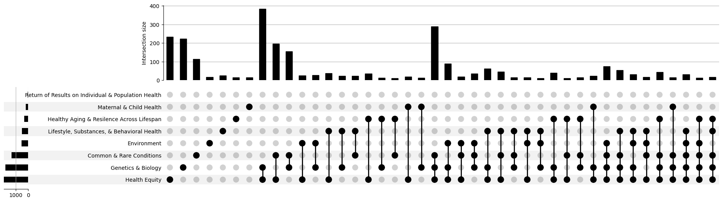
Intersections of Categories per Workspace using Limited Keywords

Slide 85
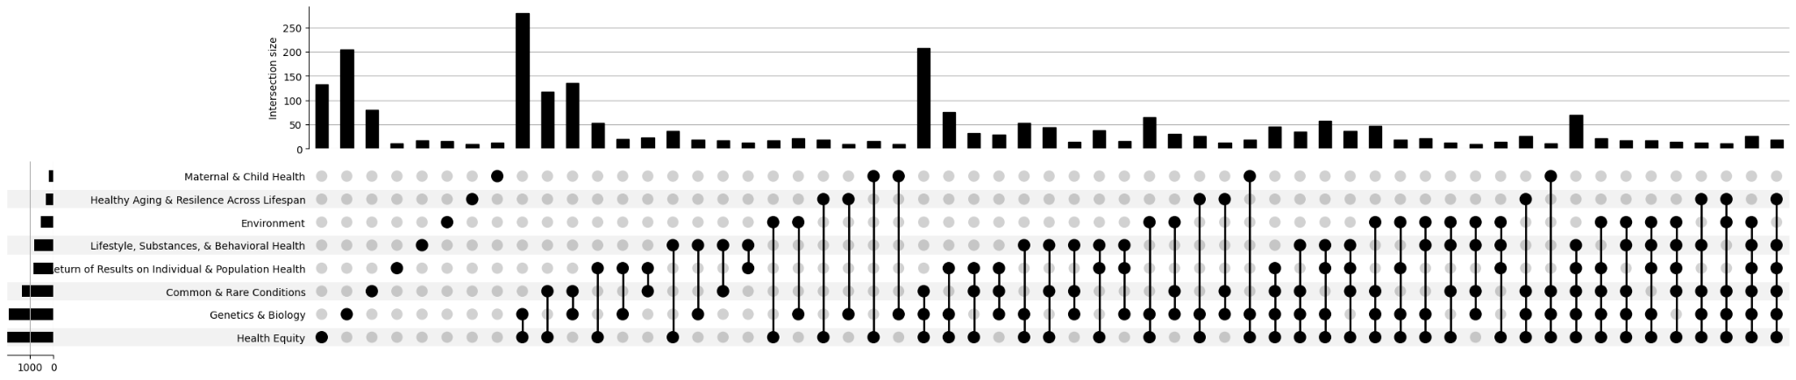
Intersections of Categories per Workspace using Limited Keywords and Research Purpose

Slide 86
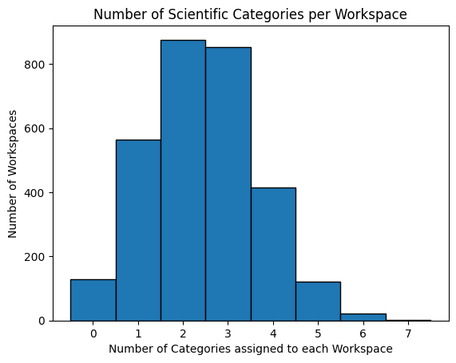
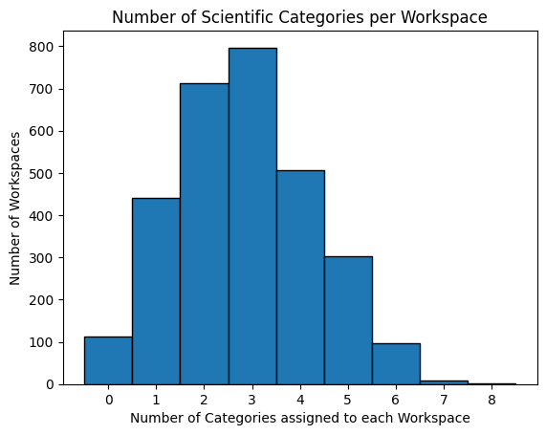
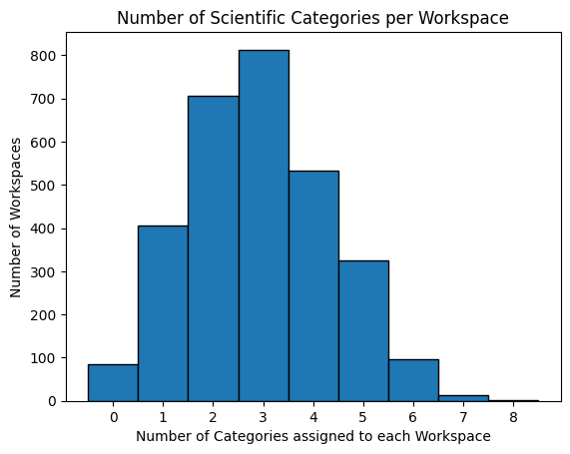
Number of Categories Assigned for Each Workspaces - All Collected Keywords
Keywords
Mapped projects 2853
Non mapped projects 128
Keywords, Research Purpose, and population of interest
Mapped projects 2896
Non mapped projects 85
Keywords and Research Purpose
Mapped projects 2868
Non mapped projects 113

Slide 87
Intersections of Categories per Workspace using Keywords

Slide 88
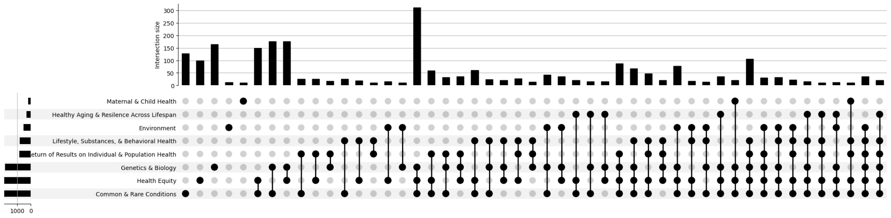
Intersections of Categories per Workspace using Keywords and Research Purpose

Slide 89
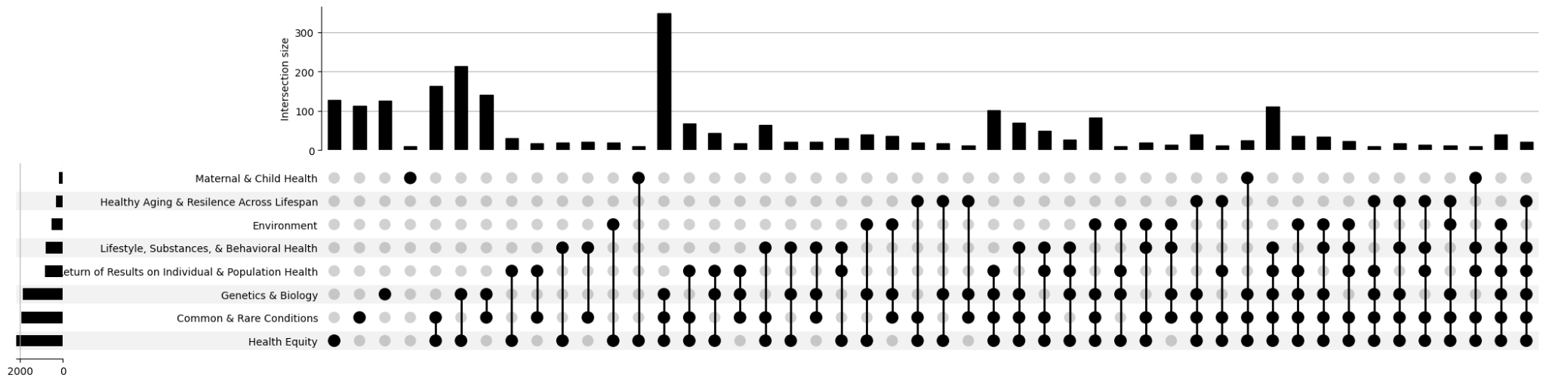
Intersections of Categories per Workspace using Keywords, Research Purpose, and population of Interest

Slide 90
Workspaces CLMAP did not Extract Disease Terms
Drugs
Statin
Warfarin
Genetics
Polygenic score
Population
Gender Identity
Income
Exploring/ Learning
Clinical practice/ Outcome
Surgical Resilience
Surgical Site Infections
Lifestyle/ Behavioural
Lifestyle
Smoking

Slide 91
Cohorts that Uses Person, conditions, or both are the Most Common Domain
<ost common

Slide 92
Results - Oct 2022 - 2467 Workspaces Analyzed - Keywords
Number of Workspaces Mapped to Scientific Focus Areas Based on Coding Scheme
Category | Subset keywords* | All Keywords | Keywords + Project purpose | Keywords + Project purpose+ population
Prevalent Common & Rare Conditions | 1086 | 1509 | 1509 | 1509
Maternal & Child Health | 149 | 149 | 149 | 149
Health Aging & Resilience Across Lifespan | 269 | 269 | 269 | 269
Return of Results on Individual & Population Health | 29 | 29 | 727 | 727
Lifestyle, Substance, & Behavioral Health | 456 | 456 | 712 | 712
Environment | 422 | 422 | 422 | 422
Health Equity | 1624 | 1624 | 1624 | 1838
Genetics & Biology | 1501 | 1501 | 1549 | 1549
Total workspaces that map according to scheme | 2318 | 2359 | 2375 | 2405
Total workspaces that do not map/require manual review | 149 | 108 | 92 | 62
* Common disease limited to top leading causes of death (https://www.cdc.gov/nchs/fastats/leading-causes-of-death.htm)

